Slide 1

X.509

Slide 2
Authentication Applications
Developed to support application-level authentication and digital signatures
Most widely used services:
  Kerberos
  X.509
Kerberos – a private-key authentication service
X.509 – a public-key directory authentication service

Slide 3
X.509 Authentication Service
ITU came up with this standard in 1988
part of X.500 directory service standards
Distributed set of servers that maintains a database about users & other Attributes.
1993 V1,1995 V2,1999 V3 by Internet Engg Task Force.
defines framework for authentication services
Each certificate contains the public key of a user and is signed with the private key of a CA.
Is used in S/MIME, IP Security, SSL/TLS and SET.
also defines authentication protocols
Notes:
X.509 is the Internationally accepted standard for how to construct a public key certificate, and is becoming widely used. It has gone through several versions. It is used by S/MIME secure email, SSL/TLS secure Internet links (eg for secure web).

Slide 4
X.509
uses public-key cryptology & digital signatures
  algorithms not standardised, but RSA recommended
X.509 certificates are widely used
Public key certificate associated with each user
  Generated by some trusted CA
Certification Authority (CA) issues certificates
The notation CA<<A>> represents a certificate for a client A signed by CA

Slide 5
X.509 Certificates
issued by a Certification Authority (CA), containing:
  version 1, 2, or 3
  serial number (unique within CA) identifying certificate
  signature algorithm identifier
  issuer X.500 name (CA)
  period of validity (from - to dates)
  subject X.500 name (name of owner)
  subject public-key info (algorithm, parameters, key)
  issuer unique identifier (v2+)
  subject unique identifier (v2+)
  extension fields (v3)
  signature (of hash of all fields in certificate)

Slide 6
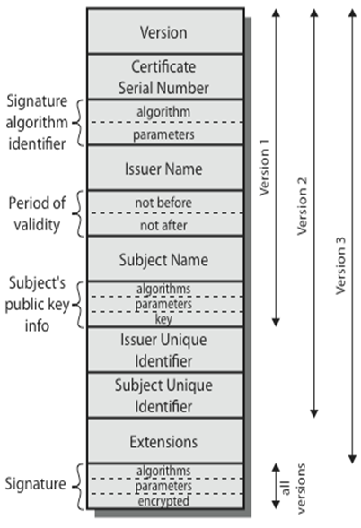
X.509 Certificates

Slide 7
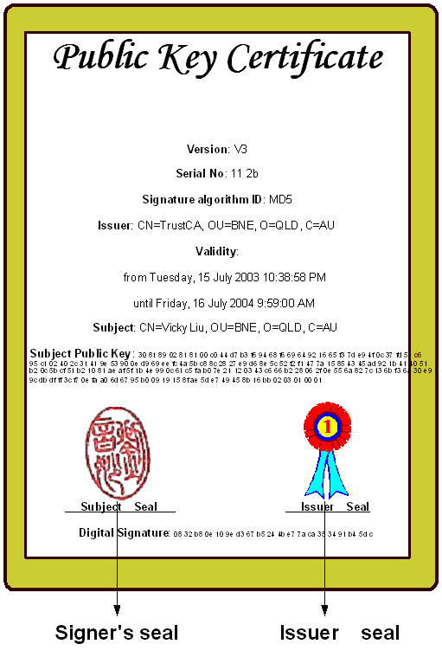

Slide 8
X.509 Version 3
has been recognised that additional information is needed in a certificate
  email/URL, policy details, usage constraints
rather than explicitly naming new fields defined a general extension method
extensions consist of:
  extension identifier
  criticality indicator
  extension value
Notes:
The X.509 version 2 format does not convey all of the information that recent design and implementation experience has shown to be needed. Rather than continue to add fields to a fixed format, standards developers felt that a more flexible approach was needed. X.509 version 3 includes a number of optional extensions that may be added to the version 2 format. Each extension consists of an extension identifier, a criticality indicator, and an extension value. The criticality indicator indicates whether an extension can be safely ignored or not (in which case if unknown the certificate is invalid).

Slide 9
Certificate Extensions
key and policy information
  convey info about subject & issuer keys, plus indicators of certificate policy
certificate subject and issuer attributes
  support alternative names, in alternative formats for certificate subject and/or issuer
certificate path constraints
  allow constraints on use of certificates by other CA’s
Notes:
The certificate extensions fall into three main categories:
key and policy information - convey additional information about the subject and issuer keys, plus indicators of certificate policy
subject and issuer attributes - support alternative names, in alternative formats, for a certificate subject or certificate issuer and can convey additional information about the certificate subject
certification path constraints - allow constraint specifications to be included in certificates issued for CA’s by other CA’s

Slide 10
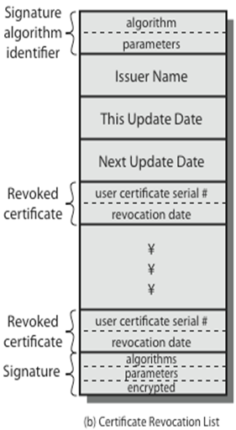
Revocation Of Certificate
Revoked before Expiry because of following reasons:
User’s Private Key Compromised.
User is not certified by CA.
CA’s certificate is compromised.
If the certificate invalidated due to
any reasons.
certificates have a period of validity
CA’s maintain list of revoked certificates
  the Certificate Revocation List (CRL)
users should check certificates with
CA’s CRL

Slide 12
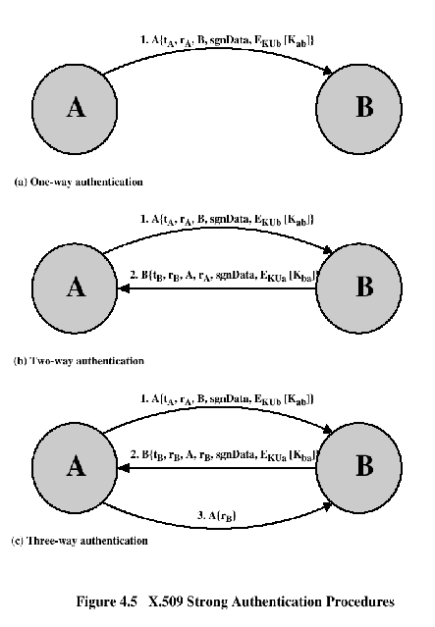
Authentication Procedures
Henric Johnson

Slide 13
X.509 Service (Continued)
Authentication procedures
  One-way
    Single transfer of information from user to user
  Two-way
    Authenticates each to the other
  Three-way
    Detects replay attacks using nonces (rather than clock synchronization)
  In security engineering, a nonce is an arbitrary number used only once in a cryptographic communication. It is similar in spirit to a nonce word, hence the name. It is often a random or pseudo-random number issued in an authentication protocol to ensure that old communications cannot be reused in replay attacks.

Slide 14
Two-Way Authentication
2 messages (A->B, B->A) which also establishes in addition:
  the identity of B and that reply is from B
  that reply is intended for A
  integrity & originality of reply
reply includes original nonce from A, also timestamp and nonce from B
may include additional info for A
Notes:
Two-way authentication thus permits both parties in a communication to verify the identity of the other, thus additionally establishing the above details. The reply message includes the nonce from A, to validate the reply. It also includes a timestamp and nonce generated by B, and possible additional information for A.

Slide 15
Three-Way Authentication
3 messages (A->B, B->A, A->B) which enables above authentication without synchronized clocks
has reply from A back to B containing signed copy of nonce from B
means that timestamps need not be checked or relied upon
Notes:
Three-Way Authentication includes a final message from A to B, which contains a signed copy of the nonce, so that timestamps need not be checked, for use when synchronized clocks are not available.

Slide 16
Summary
  Kerberos trusted key server system
  X.509 in Digital certificates

Slide 17
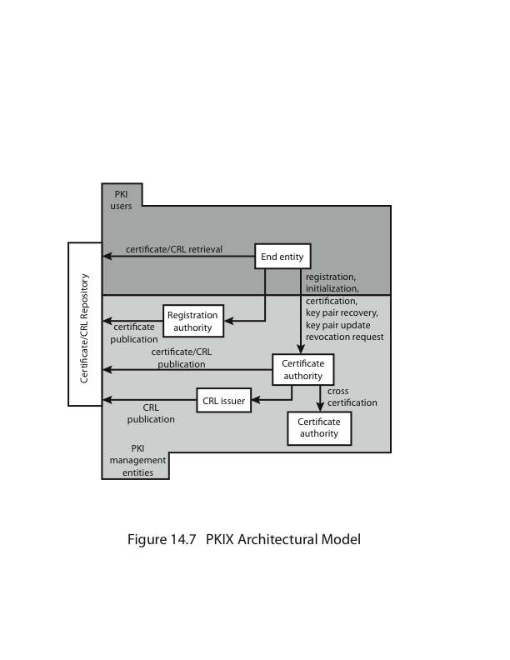
Public Key Infrastructure

